Slide 1

Capstone Project Marketing and Retail Analytics
PRESENTED BY:
Jayantika gulati
Aparna roy
Anurag pathak

Slide 2
Agenda
Objectives
Background
Data Exploration and Cleaning
Visualizations
Insights
Recommendations

Slide 3
Objective
Main objectives for this project are as follows:
To identify top products that contribute to the revenue and top product category using Pareto Analysis.
Improve our understanding with the use of market basket analysis to analyze the purchase behavior of customers.
Understand what items are most likely to be purchased individually or in combination with some other products.

Slide 4
Background
OList is an e-commerce company that has faced some losses recently and they want to manage their inventory so as to reduce any unnecessary costs.
Now to be able to meet the demands of the customers, the company would need to store tons and tons of products in warehouses.
Since storing these products adds to the costs that the company incurs, it is necessary for the organization to plan their inventory well.

Slide 5
data exploration and cleaning
Exploratory Data Analysis:-
Imported all the CSV files of Retail dataset into JupyterLab.
We used Pandas library to load and clean the dataset.
Performed data exploration on all the CSV files to understand the data quality issues.
Performed cleaning process on all the CSV files such as removing null values, duplicates records and outliers if present.
As instructed, we only considered records having order status as ’delivered’.
After cleaning all data frame we exported it back into CSV files.

Slide 6
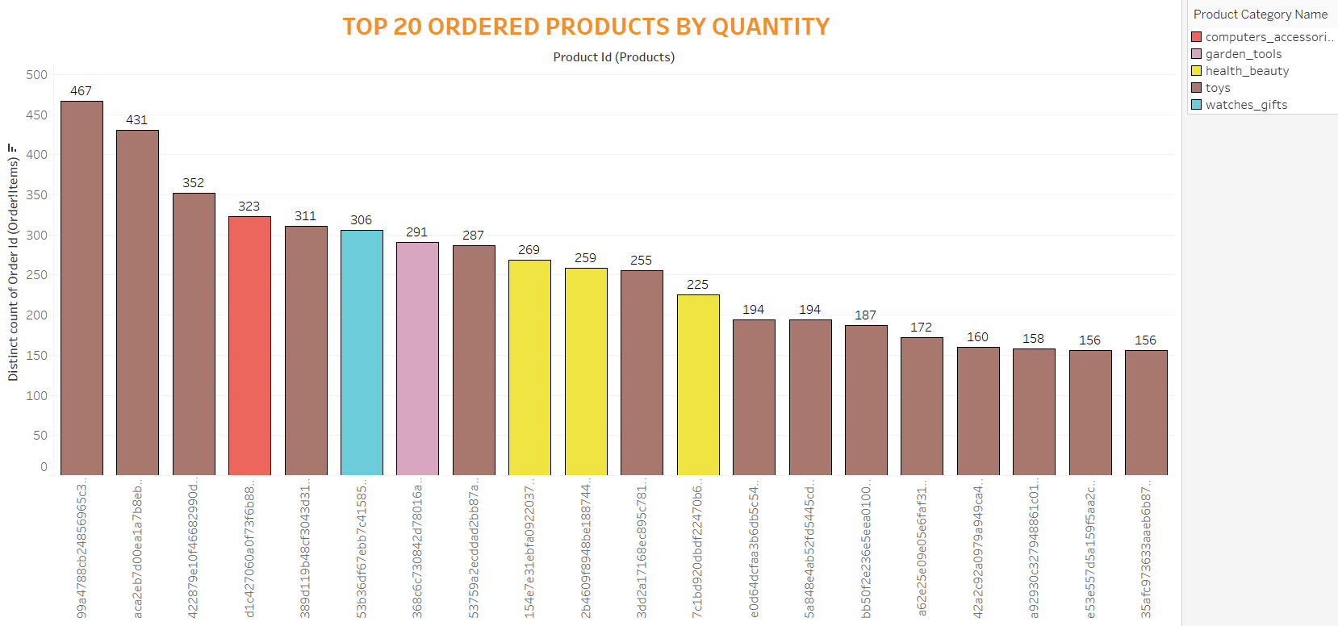
Visualizations: Top 20 Ordered Products by quantity
The highest ordered product is from the Toys category and has been ordered 467 times.
Most of the products in the Top 20 that are frequently ordered belong to the Toys category.

Slide 7
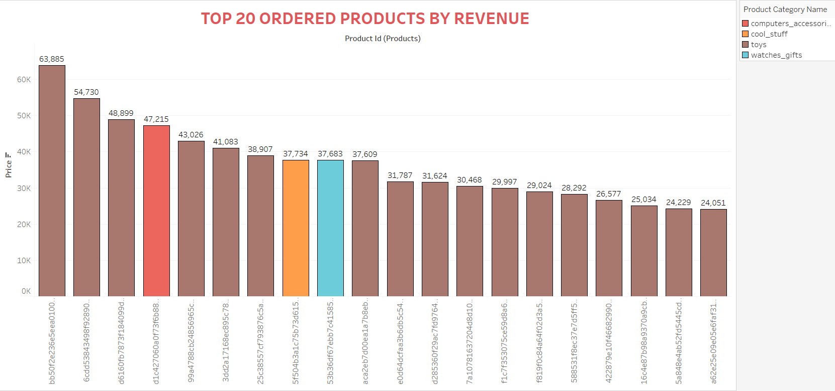
Top 20 Ordered Products by Revenue
The highest revenue generation is 63, 885 which belongs to the Toys Category.
Most of the products in the Top 20 list generating high revenue belong to the Toys category

Slide 8
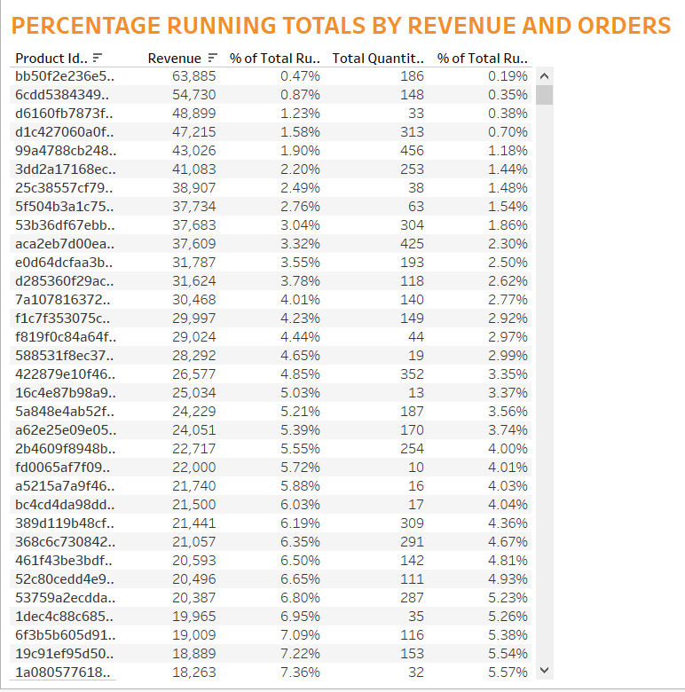
Percentage Running Total
The Percentage of Total Running Revenue and Quantity Ordered has been broken down by Product Id.
The contribution of each product towards the total revenue can be identified.

Slide 9
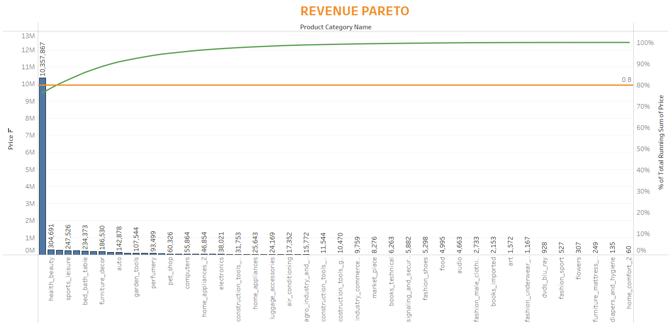
Revenue Pareto
Toys, health_beauty and watches_gift combine generate 80.56% of the revenue.
Toys alone generates 76.23% of the revenue.
The rest of the product categories generates 19.44% of the revenue.

Slide 10
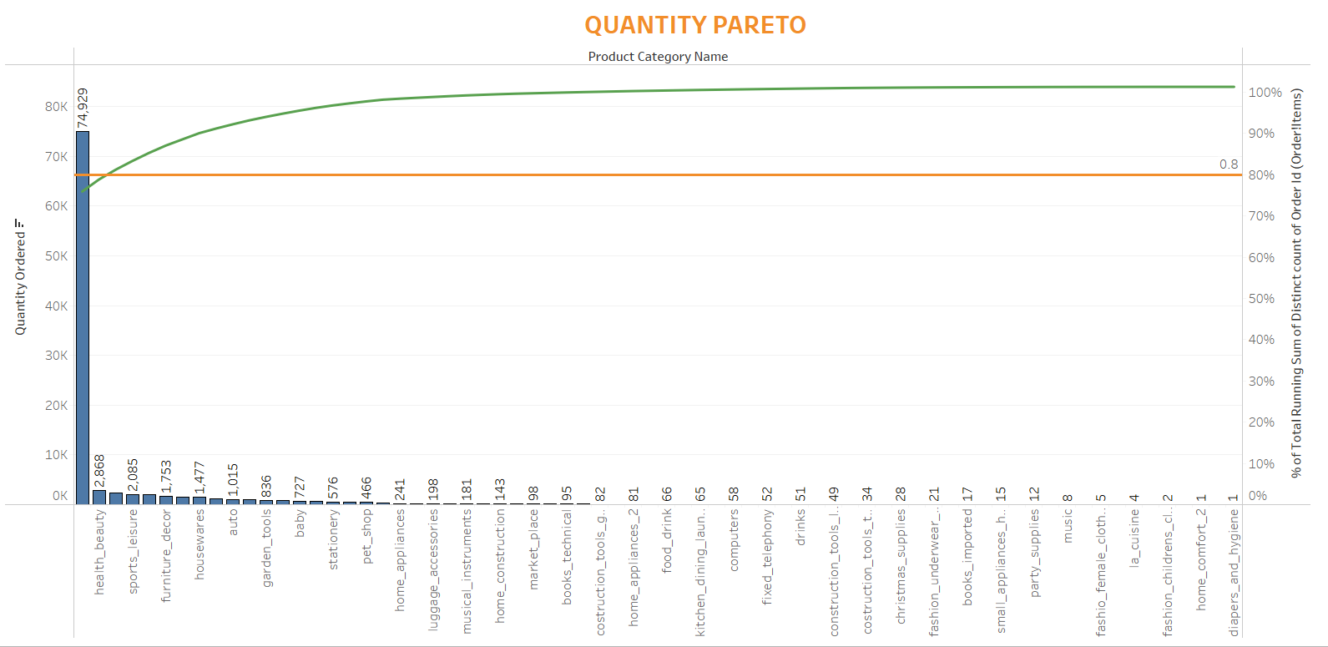
Quantity Pareto
Toys, health_beauty and bed_bath_table make up 81.22% of the total orders.
Toys alone has 75.94% of the total orders.
The rest of the product categories generate 18.78% of the total orders.

Slide 11
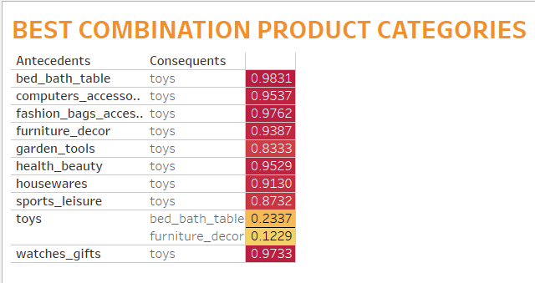
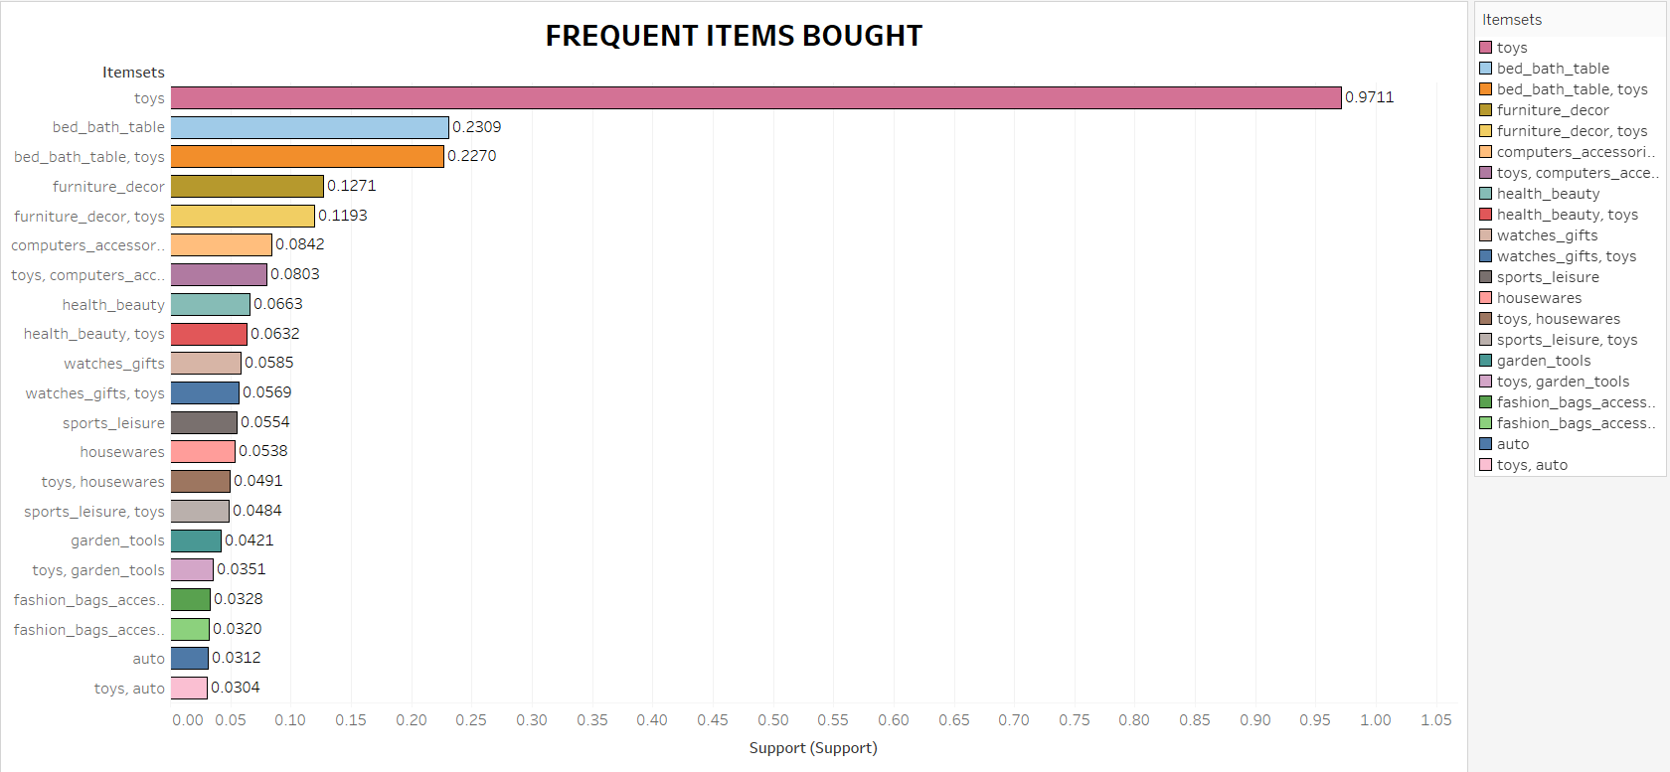
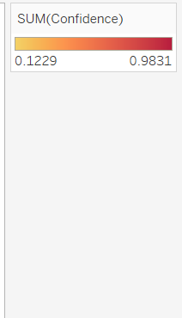

Market Basket Analysis
Market Basket Analysis is performed to identify the frequently ordered category association.
Toys are the most ordered category along with the categories of bed_bath_table, furniture_decor, computers_accessories and health_beauty.

Slide 12
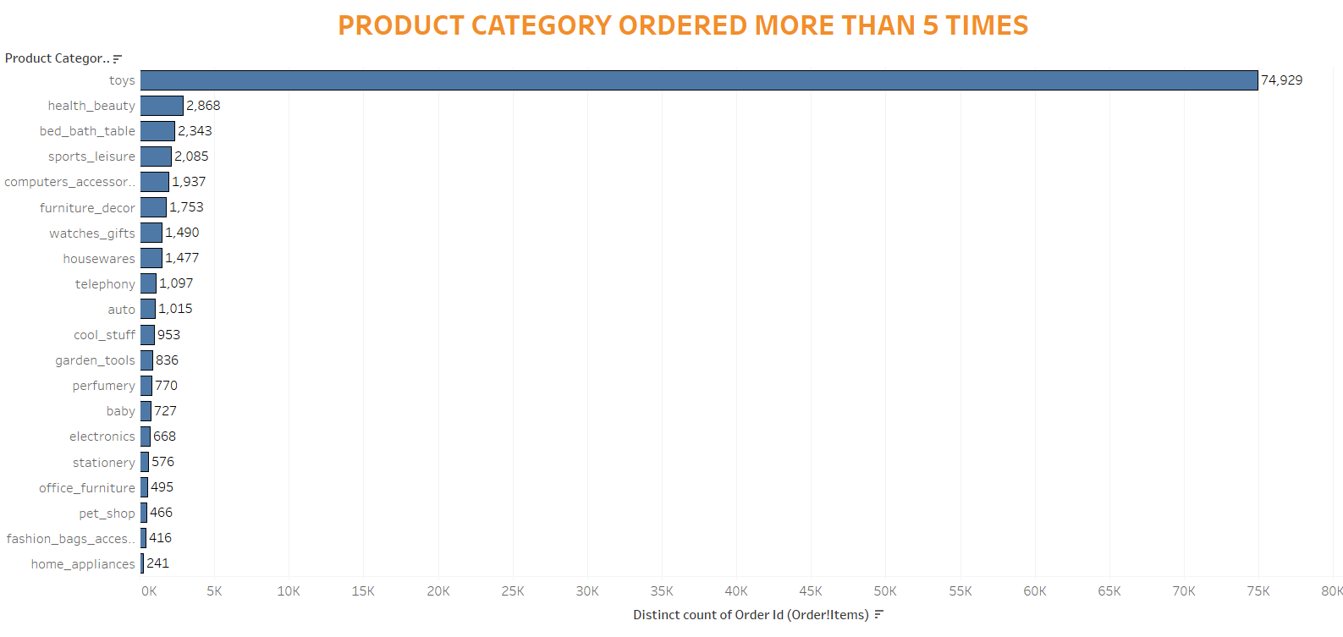
Product Category Ordered more than 5 Times
Toys category is the most ordered category with a total of 74,929 orders.
Health_beauty, bed_bath_table and sports_leisure are the next most ordered category.

Slide 13
Insights
The category Toys constitute 20% of the products which generates 80% of the revenue.
It can be seen that even if the price of the certain products is high, it is still bought by the customer more often.
Apart from Toys, the products from the categories of bed_bath_table, furniture_decor, computers_accessories and health_beauty are the most frequently ordered. The above categories with Toys or/and with each other are most frequent in customer’s basket.
It is observed that despite of the high price, some products are frequently purchased by the customers.

Slide 14
Recommendations
The company should focus on the categories which generate more than 80% of the revenue by always keeping them in stock.
The company should target customers who are more likely to buy toys to boost sales as the category toys is the most ordered category.
Company should offer lucrative offers or discounts to encourage the cross selling among their products.
The company can reduce some of the sub categories which have very low sales.
Company should start social media marketing of best selling product categories to target children of the right age group.

Slide 15
THANK YOU

